Slide 1

MACHINE LEARNING CONCEPTS
Bias-Variance Tradeoff
& the Curse of Dimensionality
Bias
Variance
Dimensionality

Slide 2
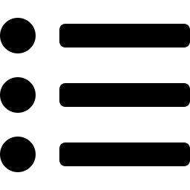
What We'll Cover
AGENDA
01
Bias & Variance
Core definitions and where each one comes from
02
Visualizing the Tradeoff
Dartboard analogy and underfit / overfit curves
03
Why the Tradeoff Exists
The error decomposition behind the U-shaped curve
04
The Curse of Dimensionality
Why more features can make models worse, not better

Slide 3
Bias vs. Variance
CORE CONCEPTS
BIAS
VARIANCE
Error from overly simplistic assumptions — the model misses real patterns in the data.
Leads to underfitting
High error on training AND test data
Typical cause: model too simple, too few features
Error from excessive sensitivity to the training data — the model fits noise, not signal.
Leads to overfitting
Low training error, high test error
Typical cause: model too complex, too little data

Slide 4

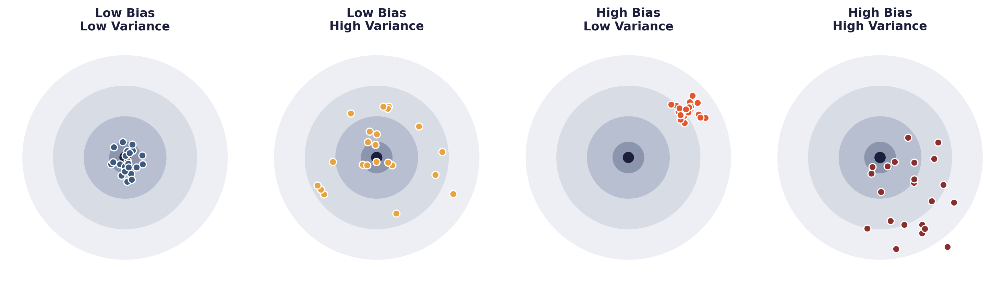
The Dartboard Analogy
VISUALIZING BIAS & VARIANCE
KEY TAKEAWAYS
Bullseye = the true value we're trying to predict
Bottom-left target is the goal — tight AND on-target
Bias pulls predictions off-target; variance scatters them
Real models rarely hit the ideal — the tradeoff is unavoidable

Slide 5

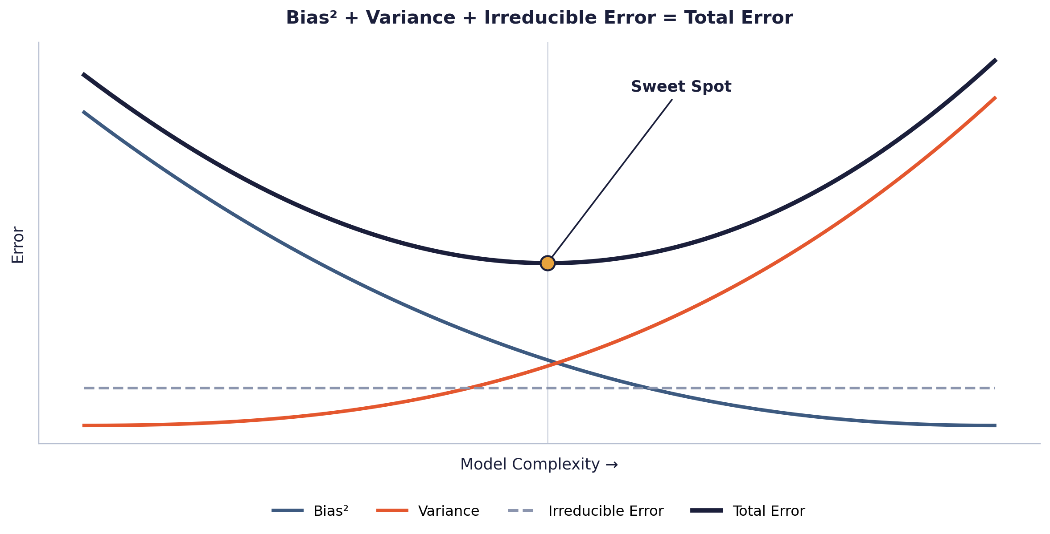
Why the Tradeoff Exists
ERROR DECOMPOSITION
Expected Error = Bias² + Variance + Irreducible Error
KEY TAKEAWAYS
Simple models: high bias, low variance
Complex models: low bias, high variance
Total error is lowest at an intermediate complexity
Bias and variance can't both be driven to zero at once

Slide 6

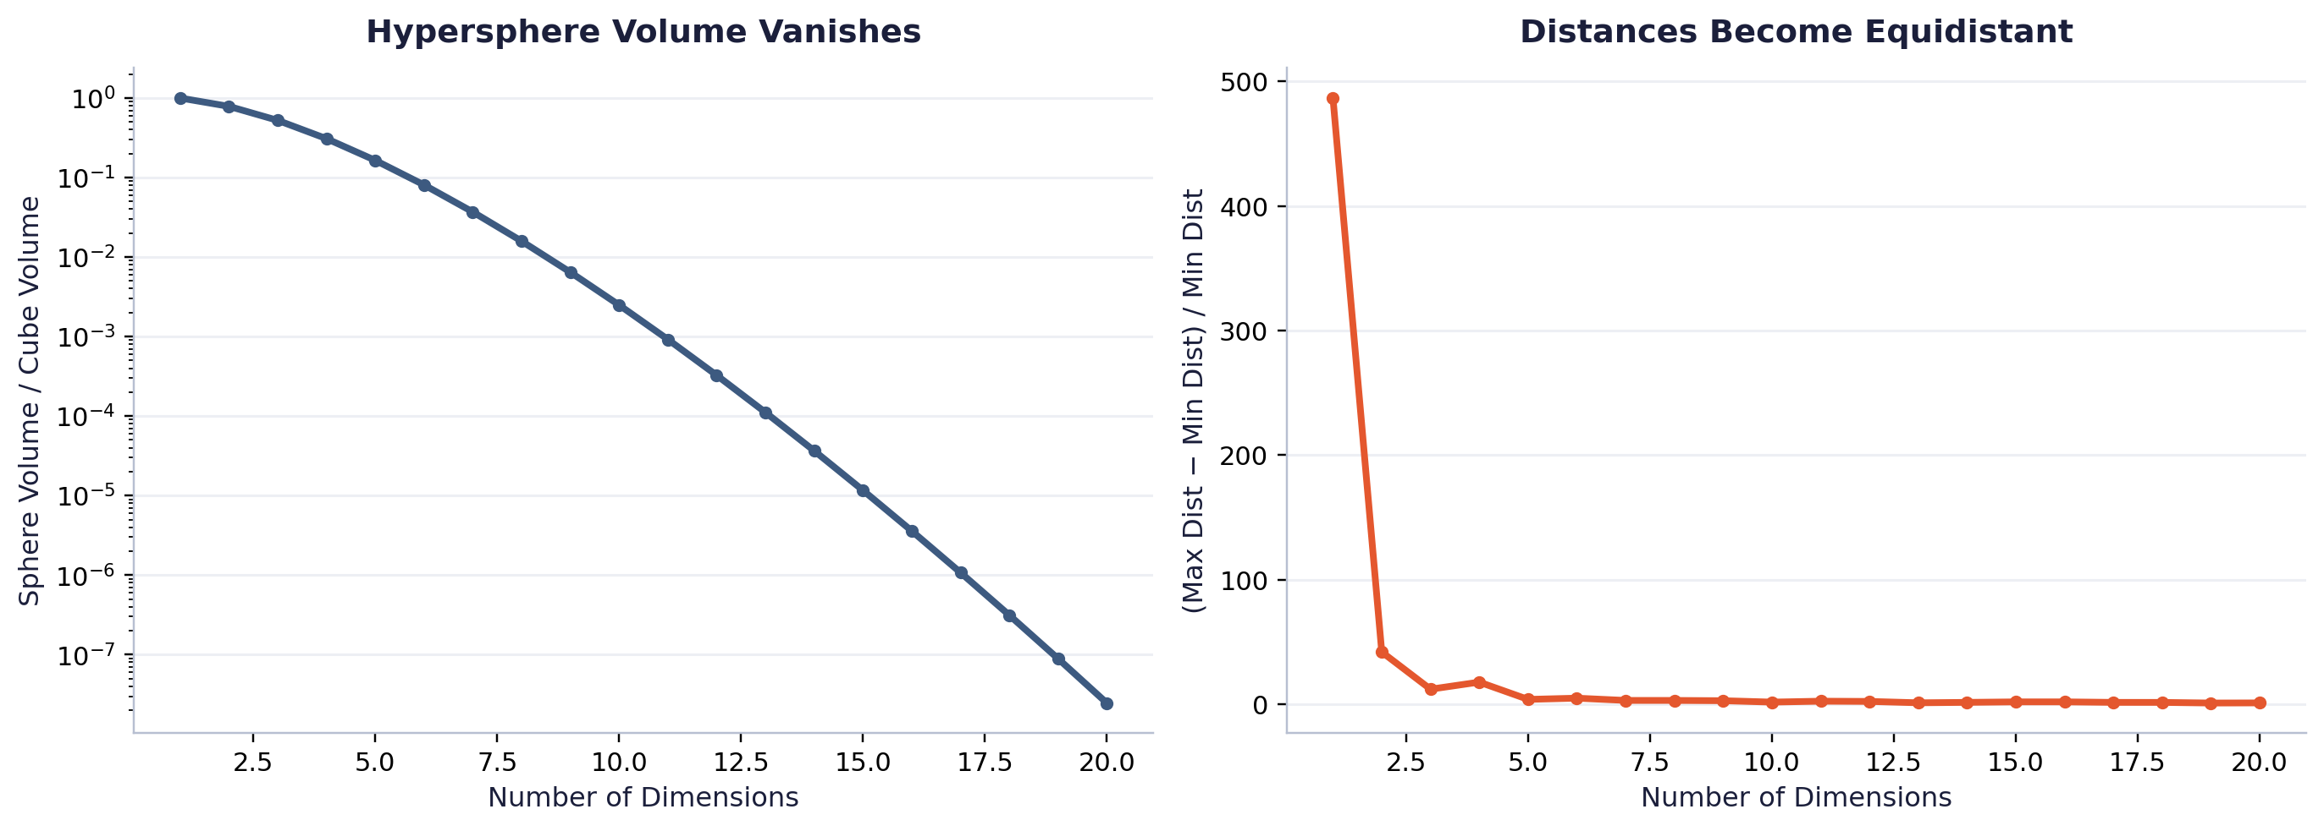
The Curse of Dimensionality
AS FEATURES GROW, SPACE EXPLODES
KEY TAKEAWAYS
Data needed to keep density constant grows exponentially with dimensions
Points “close” in 2D become nearly equidistant in 20D

Slide 7

Connecting the Dots
DIMENSIONALITY MEETS THE TRADEOFF
MORE FEATURES, MORE FLEXIBILITY
FIXED DATA, SPARSER COVERAGE
COUNTERING THE CURSE
Extra dimensions let a model fit far more complex decision boundaries — naturally pushing variance up.
The same dataset covers exponentially less of a high-dimensional space — starving the model of signal.
Dimensionality reduction (PCA)
Regularization (L1 / L2)
Feature selection
Collecting more training data

Slide 8
THANK YOU

